Slide 1
WikiNets: Lifting the Fog of Nonconnection
Jacob Cole
WikiNets.co.uk

Slide 2
"There are millions of scientists trying to cure the likes of AIDS and Alzheimer's. Maybe the cure is currently separated in different people's heads. How can we design the web so that these half-formed solutions can come together?" ~Sir Tim Berners-Lee, creator of the World Wide Web, 2011

Slide 3
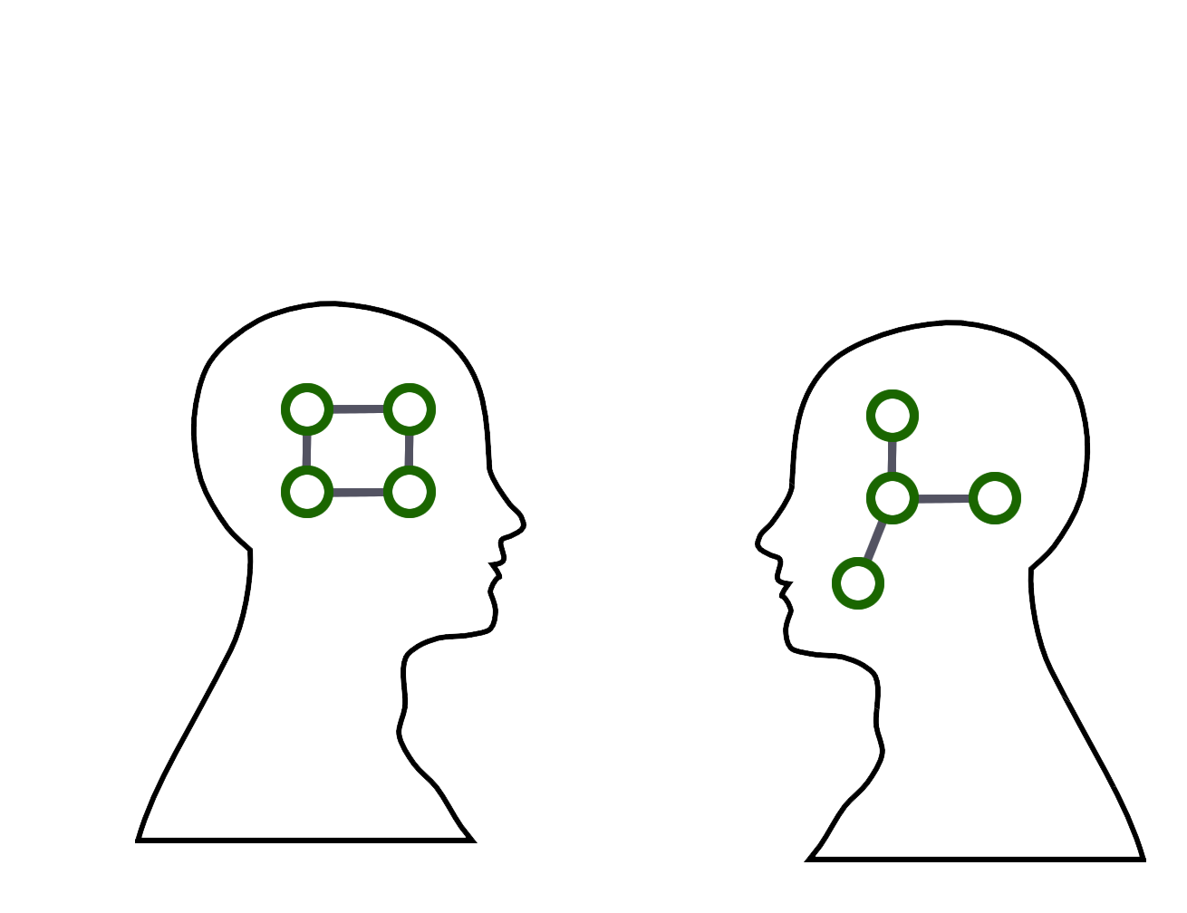

Slide 4
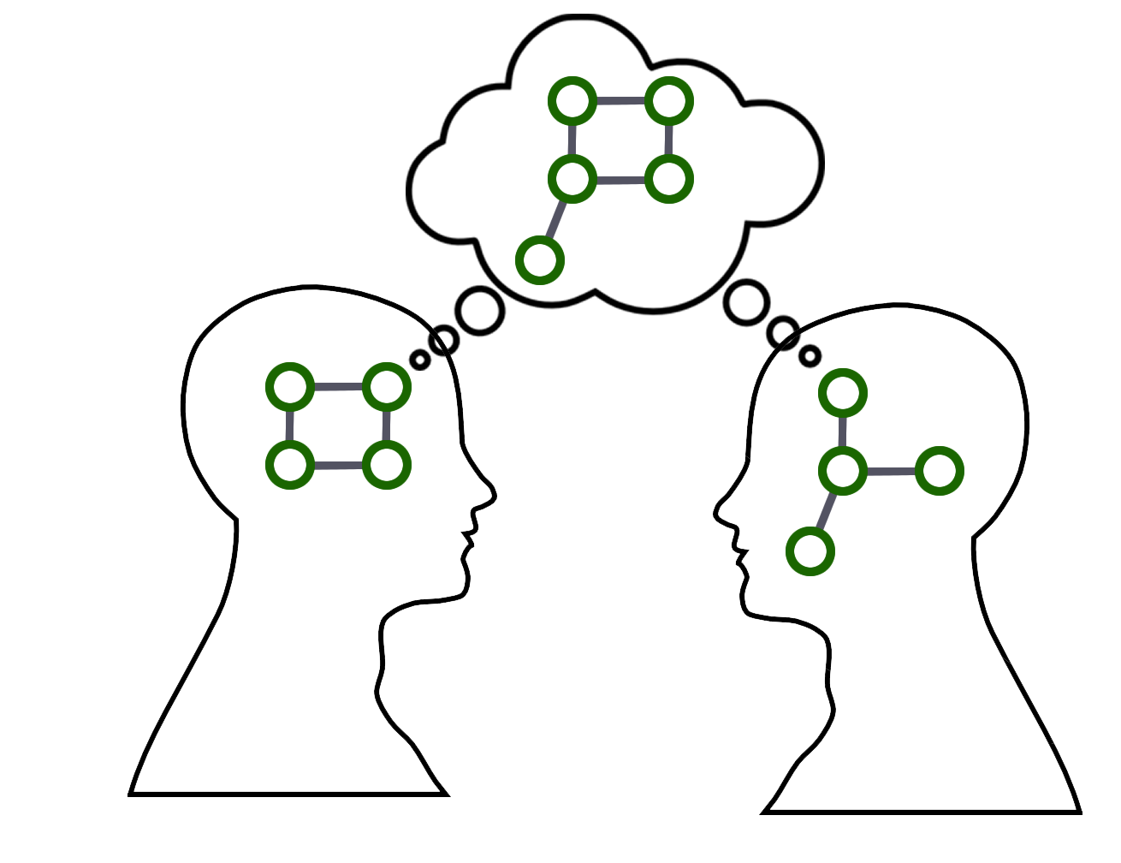

Slide 5
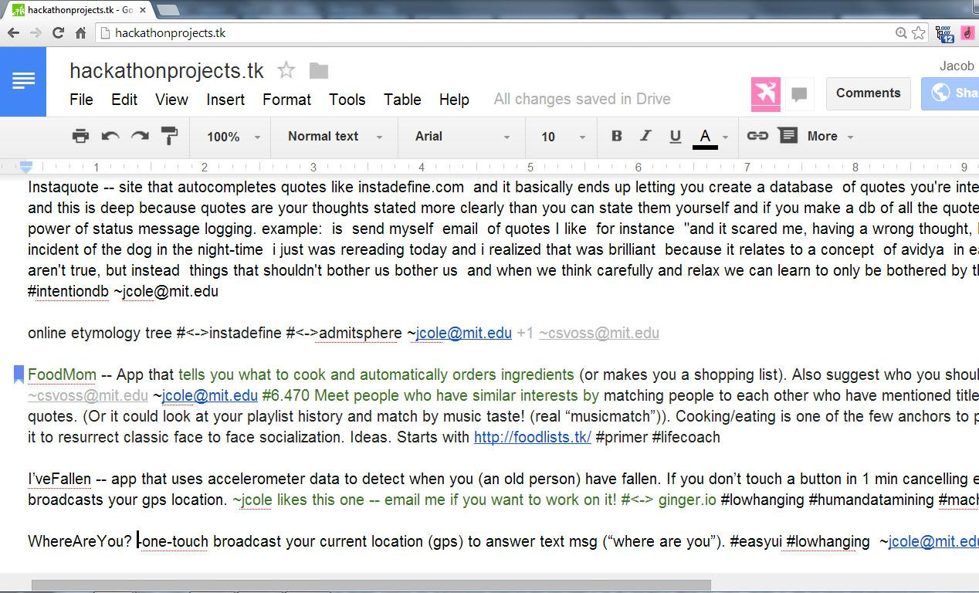

Slide 6
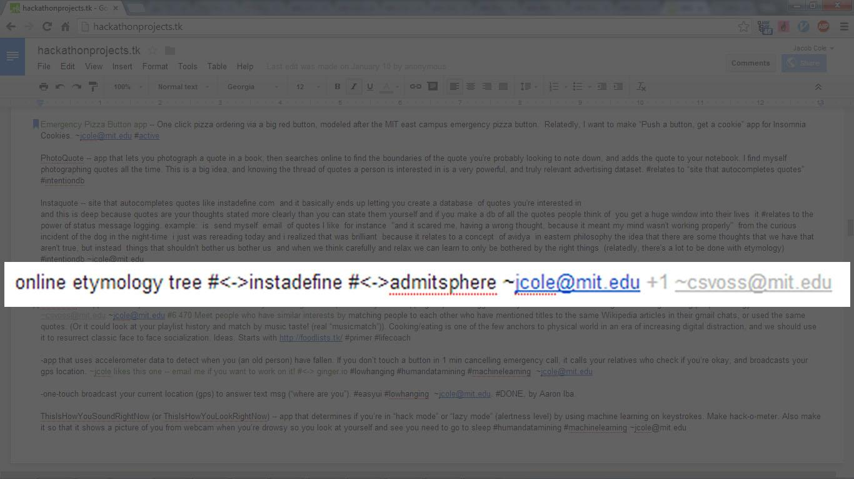

Slide 7
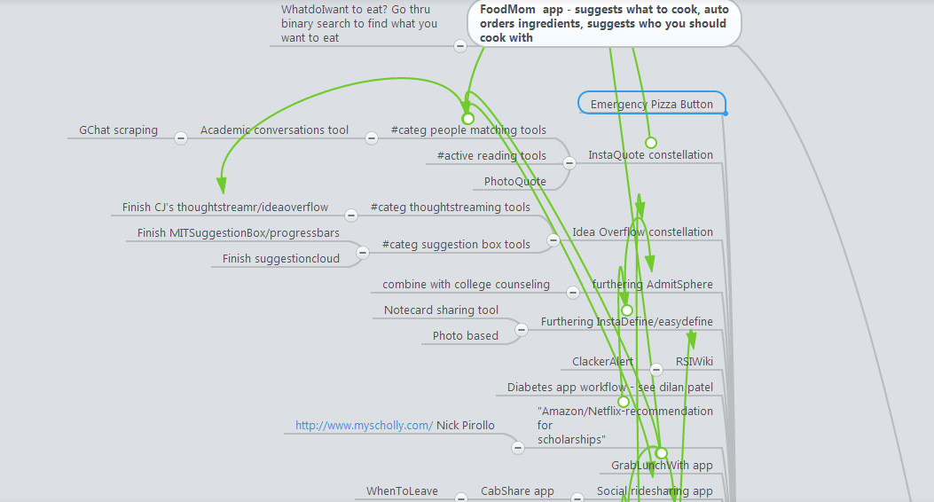
Portion of ideamap.tk,
mind map of hackathonprojects.tk
(created with mindmeister.com)

Slide 8
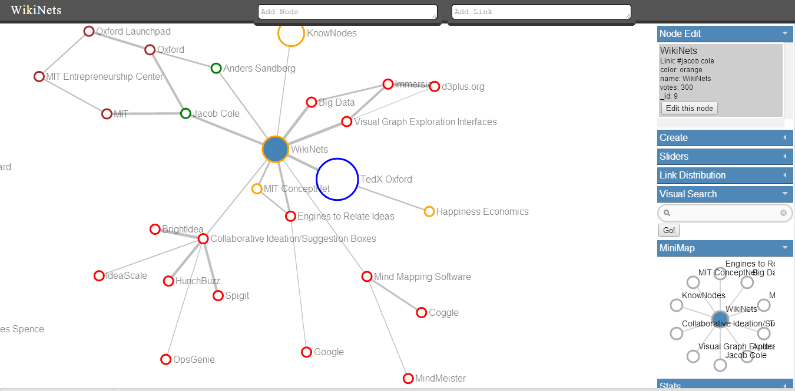
wikinets.co.uk

Slide 9
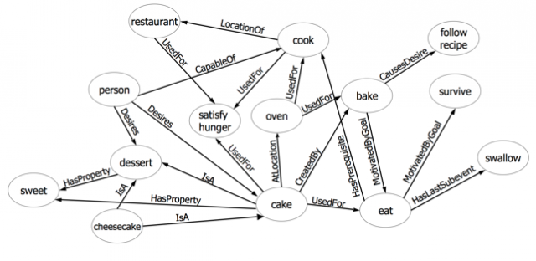
MIT ConceptNet

Slide 10


Slide 11
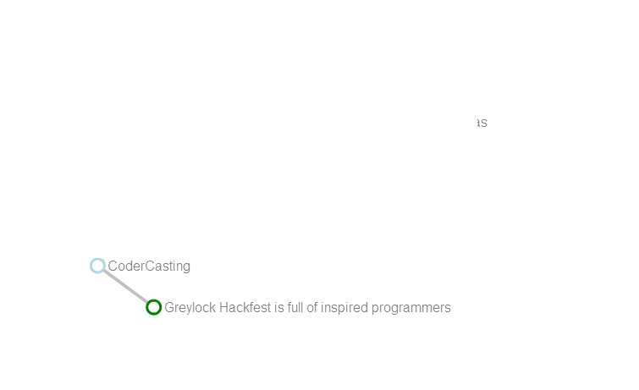

Slide 12
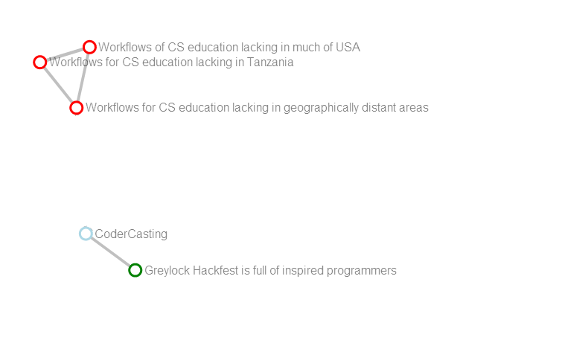

Slide 13
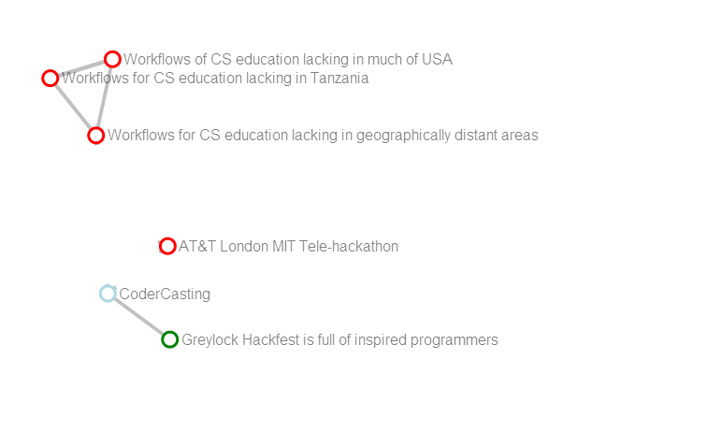

Slide 14
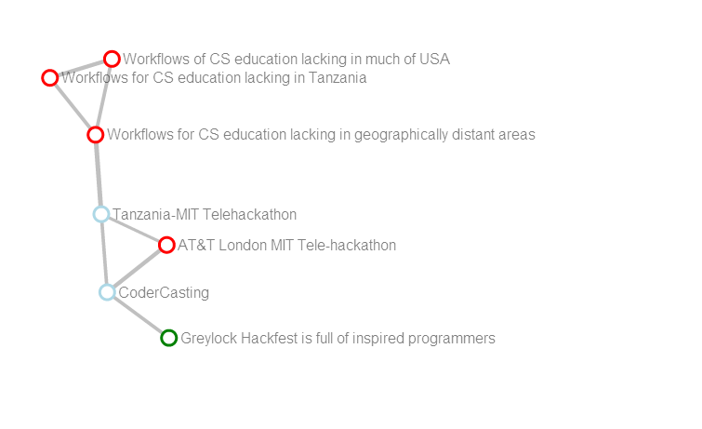

Slide 15
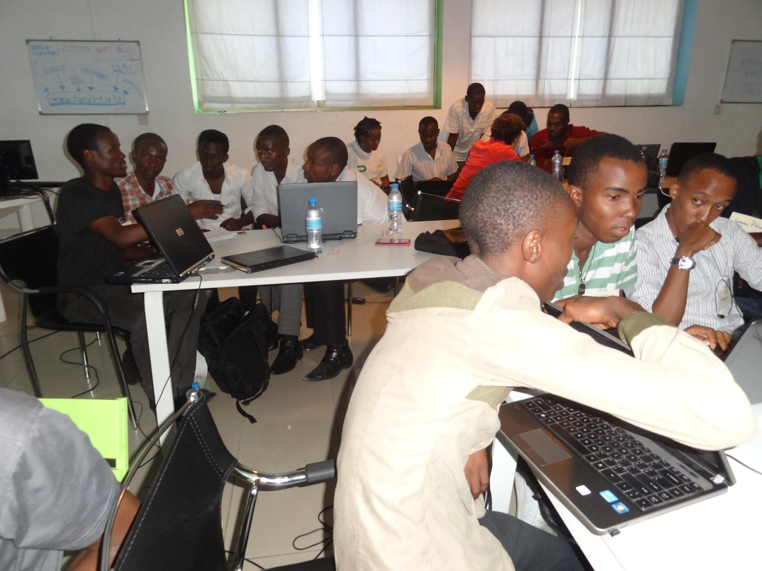

Slide 16
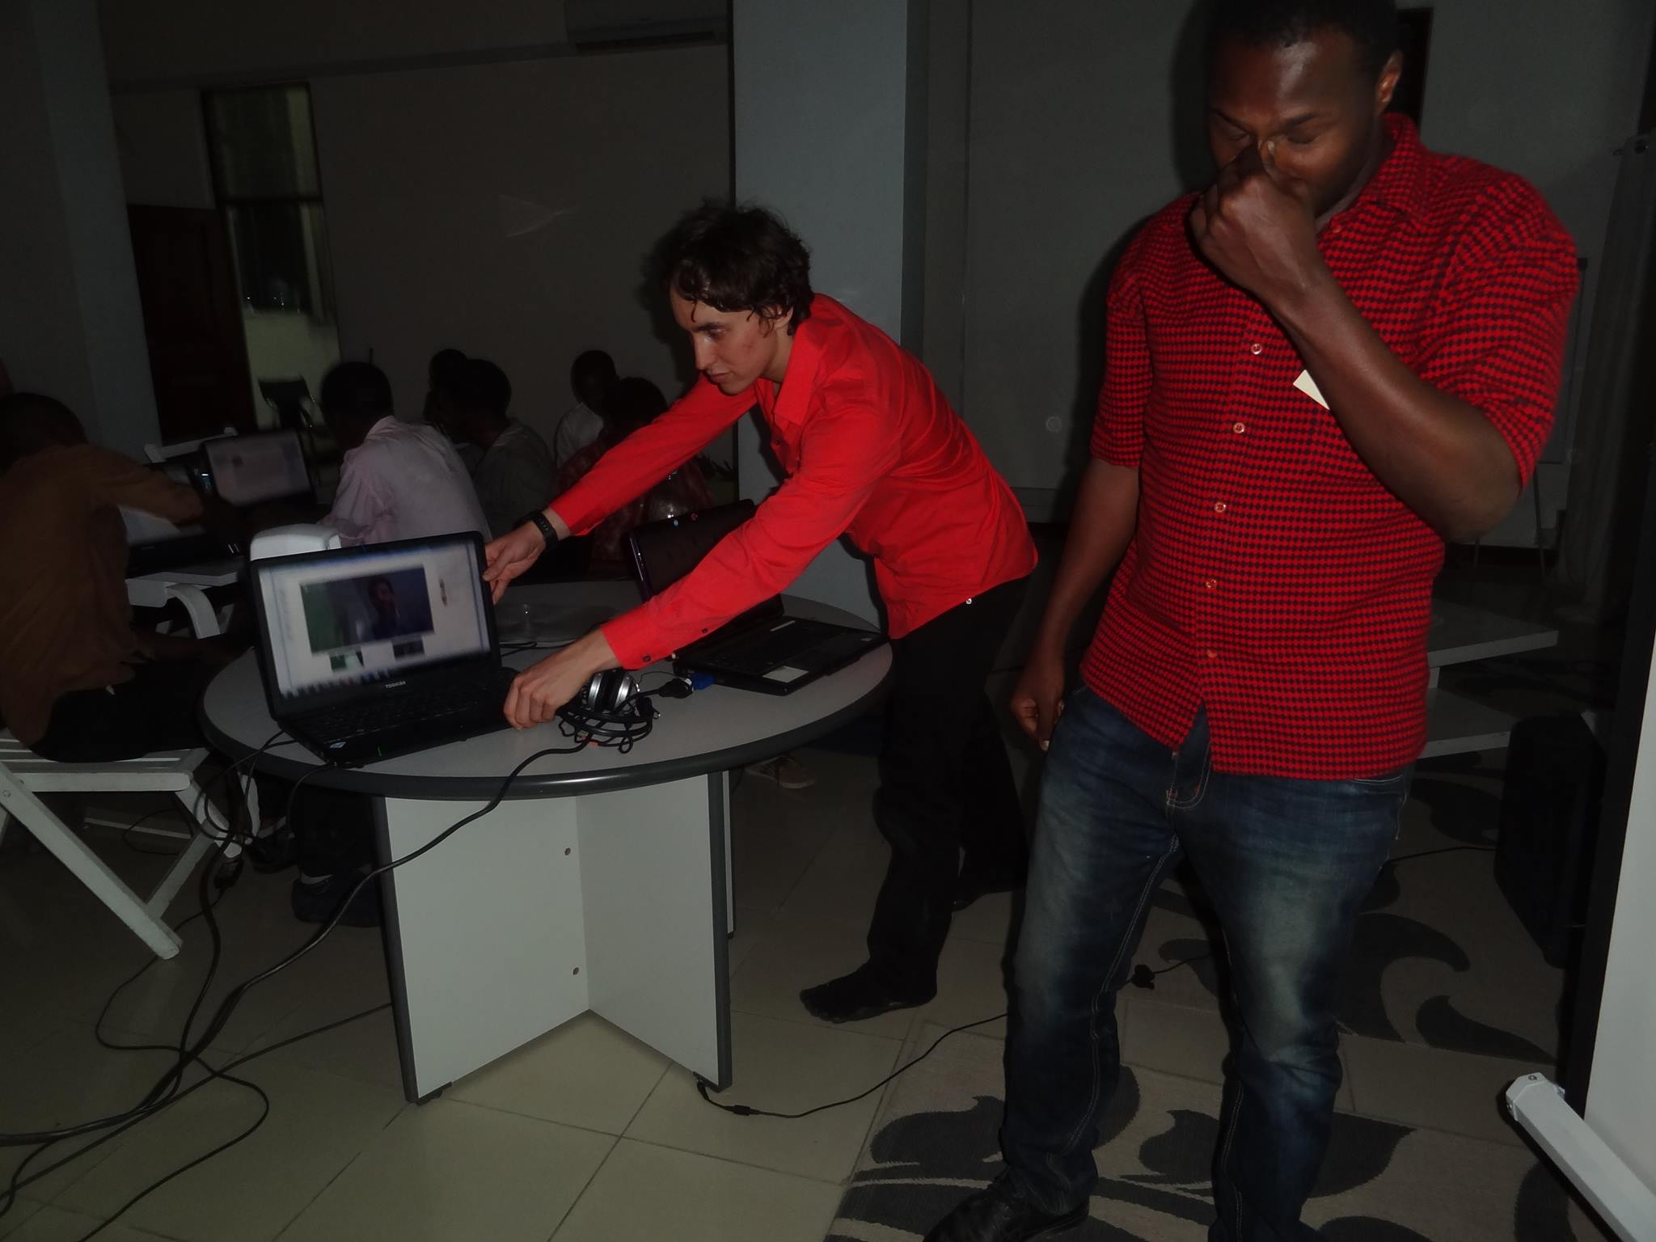

Slide 17
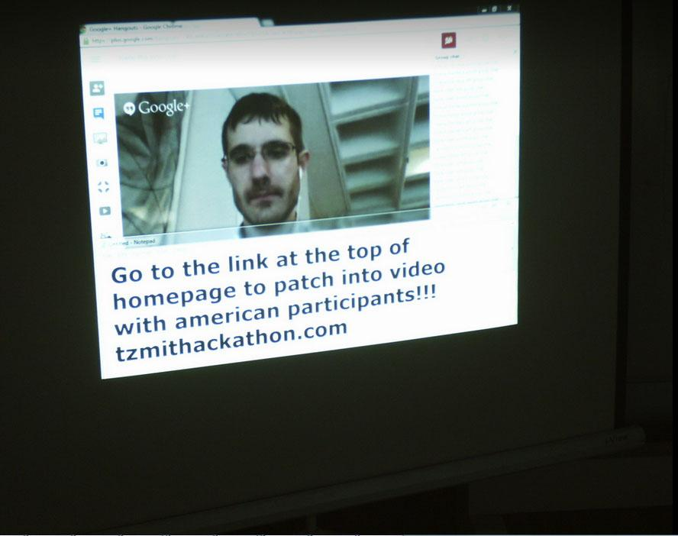

Slide 18
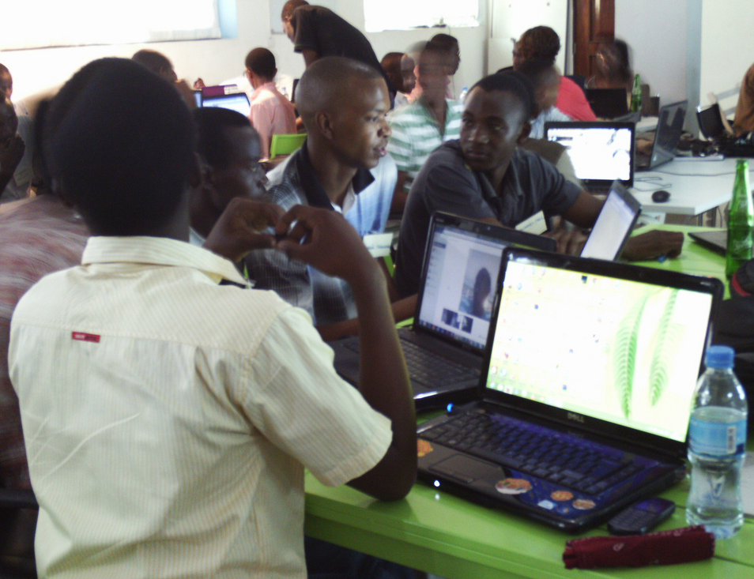

Slide 19
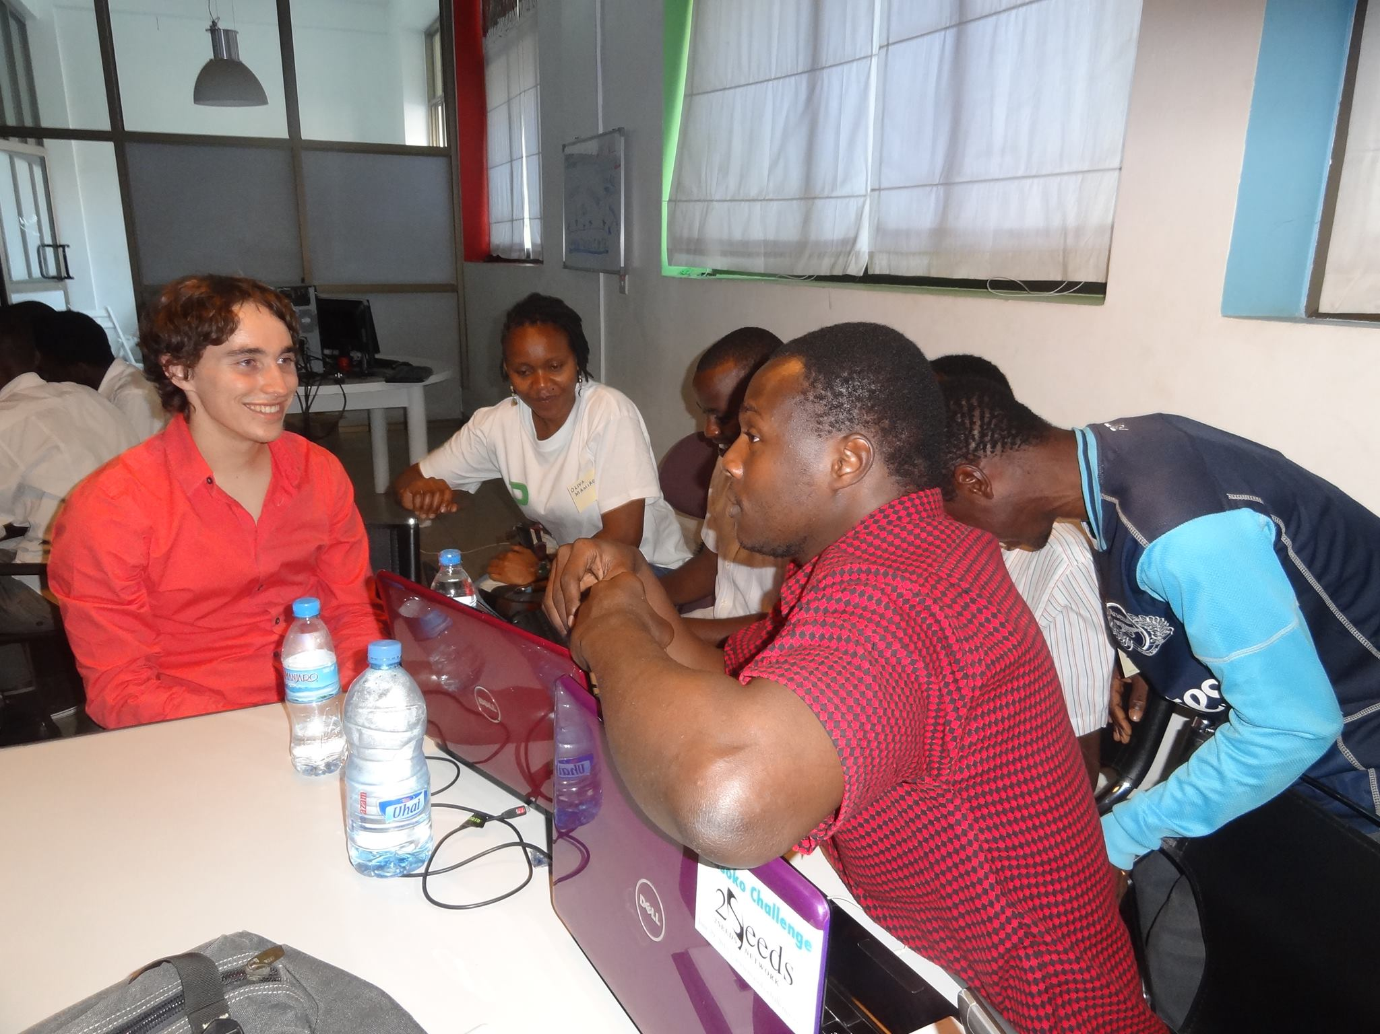

Slide 20
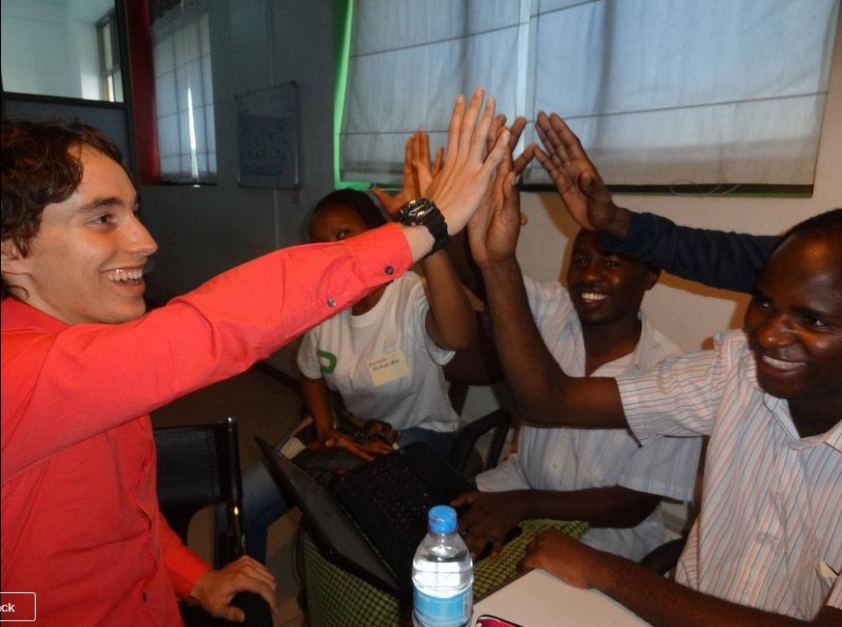

Slide 21
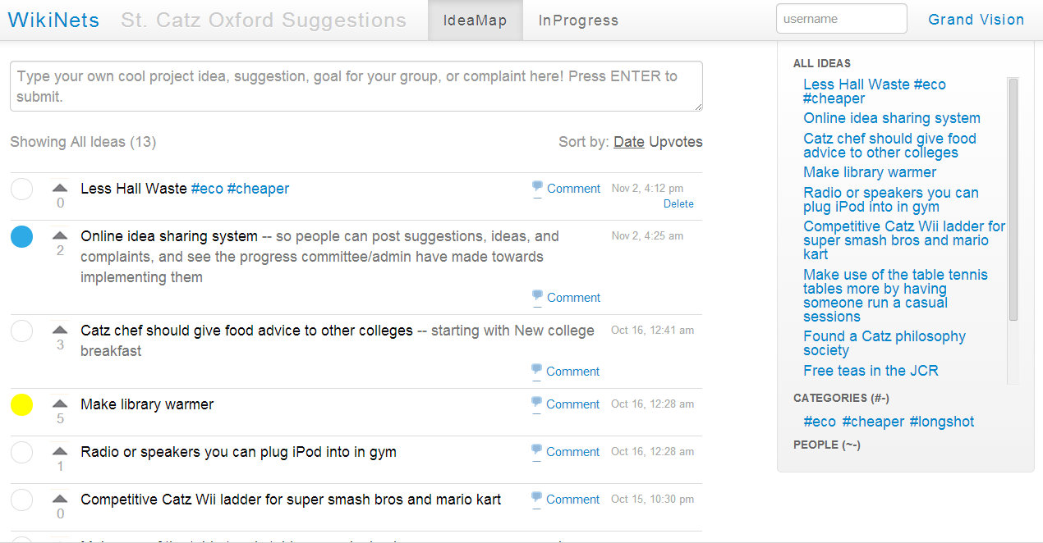
WikiNets Suggestion Box Tool: Suggestions and their Statuses

Slide 22

Kanizsa Triangle Illusion
The brain desires to close open gestalts

Slide 23
"...[the Internet] will enable the emergence of a global mind." ~Al Gore

Slide 26
Go to wikinets.co.uk
TEDx Section
-Add connections you’ve made during TEDx talks
GestaltBox Section
-Add your ideas, complaints, suggestions, goals

